Slide 1
Slide 3
List
Dasar-Dasar Pemrograman 1
Semester Ganjil 2016/2017

Slide 2
String: String Representation
Every character is encoded with an integer
UTF-8, subset of Unicode, is such an encoding
UTF = UCS Transformation Format
UCS = Universal Character Set
The function ord() takes a character and returns its UTF-8 integer value, chr() takes an integer and returns the UTF-8 character
Dasar-Dasar Pemrograman Ganjil 2016-2017

Slide 3
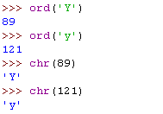
Examples
Dasar-Dasar Pemrograman Ganjil 2016-2017

Slide 4
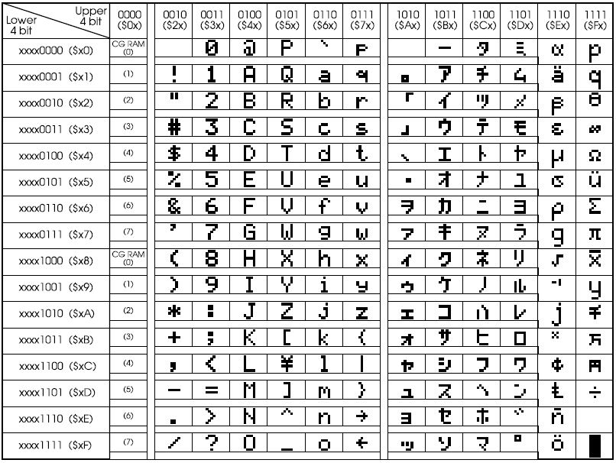
ASCII – UTF-8
Dasar-Dasar Pemrograman Ganjil 2016-2017

Slide 5
Slicing
Slicing is the process to select a subsequence of the overall sequence
It uses the syntax [start : finish] , where:
  start is the index of where we start the subsequence
  finish is the index of one after where we end the subsequence
If either start or finish are not provided, it defaults to the beginning of sequence for start and the end of the sequence for finish
Dasar-Dasar Pemrograman Ganjil 2016-2017

Slide 6
Extended Slicing
Takes three arguments
  [start:finish:countBy]
Defaults are:
  start is beginning, finish is end, countBy is 1
Example:
  var_a = ‘Apple Pie’
  var_a[:5:2]  ‘Ape’
Dasar-Dasar Pemrograman Ganjil 2016-2017

Slide 7
Example
var_a[::2]  ‘Apepe’
A | p | p | l | e |  | p | i | e
0 | 1 | 2 | 3 | 4 | 5 | 6 | 7 | 8
Dasar-Dasar Pemrograman Ganjil 2016-2017

Slide 8
Some Python Idioms
How to make a copy of a string:
  var_a = ‘universitas indonesia’
  new_var_a = var_a[:]
How to reverse a string
  var_a = ‘universitas indonesia’
  rev_a = var_a[::-1]
  print(rev_a)
    aisenodni satisrevinu
Dasar-Dasar Pemrograman Ganjil 2016-2017

Slide 9
Character Comparison
Python 3 uses the Unicode mapping for characters
UTF-8, subset of Unicode, maps the Latin alphabet, numbers and punctuation marks to integers
Single character comparisons are based on that number
Example
  ‘a’ < ‘b’  True
  ‘A’ < ‘B’  True
  ‘a’ < ‘0’  False
  ‘a’ < ‘A’  ???
Dasar-Dasar Pemrograman Ganjil 2016-2017

Slide 10
String Comparison
Compare the first element of each string
  If they are equal, move on to the next character in each
  If they are not equal, the relationship between those to characters are the relationship between the string
  If one ends up being shorter (but equal), the shorter is smaller
This method of comparison is known as lexicographic comparison
Example
  ‘a’ < ‘b’  True
  ‘aaaab’ < ‘aaaac’  True
  ‘aa’ < ‘aaz’  True
Dasar-Dasar Pemrograman Ganjil 2016-2017

Slide 11
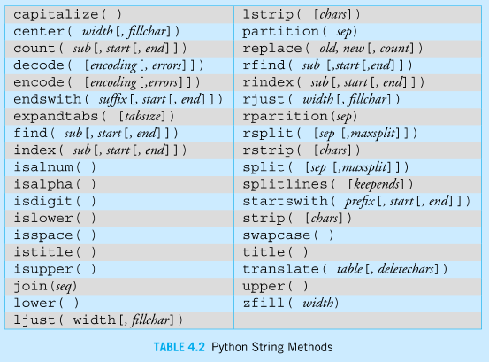
String methods
Dasar-Dasar Pemrograman Ganjil 2016-2017

Slide 12

List
In addition to number, Boolean, and string values, Python supports lists
A comma-separated sequence of items enclosed within square brackets
The items can be numbers, strings, and even other lists
>>> pets = ['ant', 'bat', 'cod', 'dog', 'elk']
>>> lst = [0, 1, 'two', 'three', [4, 'five']]
>>> nums = [0, 1, 2, 3, 4, 5, 6, 7, 8, 9, 10]
>>>
Dasar-Dasar Pemrograman Ganjil 2016-2017

Slide 13
List (1)
A list differs from a string in two fundamental ways:
  A list can contain elements of any type. Even different typed elements can be mixed together in the same list
  A list is a mutable type. This means that, unlike a string object, a list object can be changed after it constructed.
Dasar-Dasar Pemrograman Ganjil 2016-2017

Slide 14
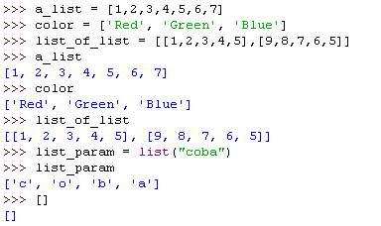
How to Make a List
Two ways:
  Using the list constructor. It takes an iterable data structure
  Using the square brackets [] to indicate explicit items
Examples
Dasar-Dasar Pemrograman Ganjil 2016-2017

Slide 15
Similarities with String Operations
Concatenate (+)
Repeat (*)
Indexing (the [] operator)
Slicing ([:])
Membership (the in operator)
len (the length function)
Dasar-Dasar Pemrograman Ganjil 2016-2017

Slide 16
Operator
[1,2,3] + [4]  [1,2,3,4]
[1,2,3] * 3  [1,2,3,1,2,3]
1 in [1,2,3]  True
[1,2,3] < [1,2,4]  True
  Compare index to index, first difference determines the result
Dasar-Dasar Pemrograman Ganjil 2016-2017

Slide 17
Indexing
list_a = [1, “Dua”, 3.0]
list_a[1]  ‘Dua’
list_a[:2]  [1,’Dua’]
1 | “Dua” | 3.0
0 | 1 | 2
-3 | -2 | -1
Dasar-Dasar Pemrograman Ganjil 2016-2017

Slide 18
Indexing (1)
What does the [] mean, a list or an index?
  [1,2,3] [1]  2
Index always comes at the end of an expression, and is preceded by something (a variable, a sequence)
Dasar-Dasar Pemrograman Ganjil 2016-2017

Slide 19
List of lists
list_a = [‘a’, [1,2,3], ‘b’]
What is the element of list_a[1] ?
list_a[1][0] #apply left to right
  list_a [1]  [1,2,3]
    [1,2,3] [0]  1
Dasar-Dasar Pemrograman Ganjil 2016-2017

Slide 20
List Functions
len (lst): number of elements in list (top level)
  len ([1,2,3],1,3)  3
min (lst): smallest element. Must all be the same type
max (lst): largest element. Must all be the same type
sum (lst): sum of the elements, numeric only
Dasar-Dasar Pemrograman Ganjil 2016-2017

Slide 21
List Methods
Remember, a function is a small program (such as len) that takes some arguments; the stuff in the parenthesis; and returns some value
A method is a function called in a special way, the dot call. It is called in the context of an object (or a variable associated with an object)
Dasar-Dasar Pemrograman Ganjil 2016-2017

Slide 22
List Methods
my_list = [1,2,3]
my_list.append(‘a’)
Arguments to the method
The object which we are calling the method
The name of the method
Dasar-Dasar Pemrograman Ganjil 2016-2017

Slide 23
Some new methods
A list is mutable (can change):
  a_list[0] = ‘b’ #index assignment
  a_list.append()
  a_list.extend()
  a_list.pop()
  a_list.insert()
  a_list.remove()
  a_list.sort()
  a_list.reverse
Dasar-Dasar Pemrograman Ganjil 2016-2017

Slide 24
More about list methods
Most of these methods do not return a value
This is because lists are mutable, so the methods modify the list directly. No need to return anything.
Dasar-Dasar Pemrograman Ganjil 2016-2017

Slide 25
Unusual results! Disaster!
a_list = [2,5,6,4,7,8]
a_list = a_list.sort()
a_list  None
What happened was the sort operation changed the order of the list in place (right side of assignment). Then the sort method returned None, which was assigned to the variable. The list was lost and None is now the value of the variable
Dasar-Dasar Pemrograman Ganjil 2016-2017

Slide 26
Split
The string method split generates a list of strings by splitting the original string at certain separators
split_list = ‘ini hanya untuk coba coba’
split_list  [‘ini’, ‘hanya’, ‘untuk’, ‘coba’, ‘coba’]
Dasar-Dasar Pemrograman Ganjil 2016-2017

Slide 27
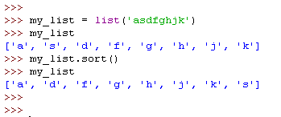
Sorting
Only lists have a built-in sorting method. Thus you often convert your data to a list if it needs sorting
Dasar-Dasar Pemrograman Ganjil 2016-2017

Slide 28
Review about variables
A variable name comes into existence when it is associated with a value, e.g. x = 5
A variable name has no specific type associated with it
Once made, a variable is associated with a particular Python object (and that object has a type)
Python maintains a namespace that keeps track of variables and the objects they are associated with
Computer scientists often refer to this association as a reference. That is, a varable name “references” an object
Programming languages handle referencing in different ways. In Python, references are maintabed in the namespace. A namespace maintains the association or reference between a variable name and an object
Dasar-Dasar Pemrograman Ganjil 2016-2017

Slide 29
Review about assignment
Assignment takes an object from the RHS and associates it with a variable on the LHS
When you assign one variable to another, you share the association with the same object
Dasar-Dasar Pemrograman Ganjil 2016-2017

Slide 30
Immutable
Immutable object sharing (two variables associated with the same object) is not a problem since the object cannot be changed.
Any changes that occur generate a new object
Dasar-Dasar Pemrograman Ganjil 2016-2017

Slide 31
Examples
Name list
Name list
var_a
1
2
var_a
var_b
var_b
1
var_a = 1
var_b = var_a
var_a = 1
var_b = var_a
var_a = var_a+1
Dasar-Dasar Pemrograman Ganjil 2016-2017

Slide 32
Mutability
If two variables associate with the same mutable object, then both reflect any change to that object
List are mutable, yet String are immutable
Dasar-Dasar Pemrograman Ganjil 2016-2017

Slide 33
Example
Name list
var_a
[1,2,3]
var_b
var_a = [1,2,3]
var_b = var_a
Dasar-Dasar Pemrograman Ganjil 2016-2017

Slide 34
Example (1)
Name list
var_a
[1,2,3,4]
var_b
var_a = [1,2,3]
var_b = var_a
var_a.append(4)
Dasar-Dasar Pemrograman Ganjil 2016-2017

Slide 35
References
William Punch & Richard Enbody. The Practice of Computing using Python, 2nd Edition. Addison-Wesley, 2013
Y. Daniel Liang. Introduction to Programming Using Python. Prentice Hall, 2013.
John Zelle. Python Programming: An Introduction to Computer Science, 2nd Edition. Franklin, Beedle & Associates Inc., 2010.
Mark Lutz. Learning Python, 5th Edition. O’Reilly Media. Copyright 2013 Mark Lutz, 978-1-44-93-5573-9
L. Y. Stefanus. Slide Pelatihan Python. 2015.
Dasar-Dasar Pemrograman Ganjil 2016-2017

